Slide 1
GreatPM
An AI product-management operating system
Native plugins for Codex and Claude Code
Optional read-only MCP knowledge channel
Vandana Ajay Dubey
Assignment 4 - C51
01
Notes:
GreatPM product-management buildathon submission. Native package v1.1.6. Source: https://github.com/VandanaAjayDubey111/great-pm. No adoption or outcome metrics claimed.

Slide 2
The product decision problem
Intended users
Founder-PMs and small product teams
working inside an AI coding environment
A fuzzy request can become a build
Context fragments across the work
The user, desired outcome and evidence may remain unclear while an AI assistant starts producing artifacts.
Research, strategy and product requirements need continuity as the team moves toward launch.
Product hypotheses to validate with independent users
02
Notes:
Intended users and pain statements are product hypotheses, not independently validated market findings. Source: https://github.com/VandanaAjayDubey111/great-pm/blob/main/README.md. Talk track: focus on deciding which product to build and why. Task tracking supports that process.

Slide 3
The GreatPM proposition
A structured product process in the AI workspace
Specialist roles draft the work. Project memory carries context.
The human approves consequential decisions.
48 | 79 | 34 | 26
Specialist definitions | Product-management skills | Workflows | Templates
Full native package in Codex and Claude Code
03
Notes:
Sources: https://github.com/VandanaAjayDubey111/great-pm/blob/main/README.md and native package v1.1.6 inventory. Counts are separate categories, not simultaneous agents, adoption or test coverage: 48 specialist definitions, 79 product-management skills, 34 workflows and 26 templates.

Slide 4
Six stages with three human gates
Stage | Typical product work | Human control
Discover | Evidence and customer needs
Strategize | Positioning and product direction
Prioritize | Tradeoffs and roadmap | Strategy approval
Define | PRD and success metrics | Specification approval
Launch | Readiness and rollout | Launch approval
Measure | Results and next questions | Next discovery cycle
Agents propose. The human approves strategy, specification and launch.
04
Notes:
Sources: https://github.com/VandanaAjayDubey111/great-pm/blob/main/README.md and https://github.com/VandanaAjayDubey111/great-pm/blob/main/docs/CODEX.md. Only the human may approve gate:strategy, gate:spec and gate:launch. The specification gate precedes build. Measure feeds the next discovery cycle.

Slide 5
GreatPM Grill Me
$grill-me
Challenges fuzzy thinking before a team commits
Illustrative request
Questions worth answering
“Add an AI onboarding assistant.”
Who gets stuck today?
Where does onboarding break?
Could a simpler change solve it?
Output: a sharper situation brief and explicit unknowns.
The human can answer, skip or override.
05
Notes:
Illustrative example only. Source: https://github.com/VandanaAjayDubey111/great-pm/blob/main/agents/grill-me.md. Codex public name is $grill-me. It asks adaptive rounds about the situation, widens understanding, records unknowns and produces a situation brief at any stage when thinking is fuzzy. The human can answer, skip or override. Inspiration credit: Matt Pocock, https://www.aihero.dev/my-grill-me-skill-has-gone-viral.

Slide 6
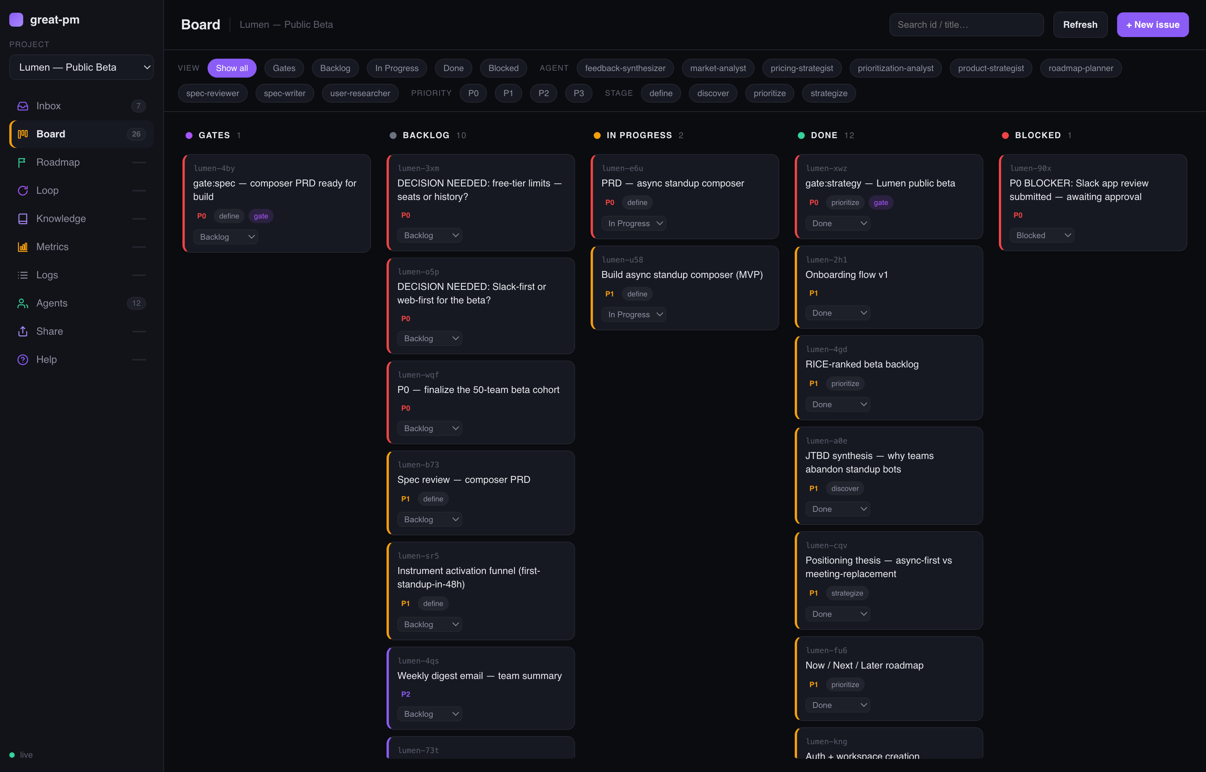
The local product board
Demo data
One place to inspect
product work and
pending decisions
A local view of the
project’s .great-pm state
06
Notes:
Source image: https://github.com/VandanaAjayDubey111/great-pm/blob/main/docs/screenshots/board.png. All Lumen records are demo data, not evidence of customers, adoption or a real beta. Talk track: point to pending gates and unresolved product choices.

Slide 7
Native plugin and MCP have different roles
Capability | Full native plugin | Optional public MCP
Primary use | Run product workflows | Retrieve methods and prepare plans
Product knowledge | 79 skills and 26 templates | 28 methods and 10 templates
Specialist workflow | 48 role definitions | No agent execution
Project continuity | Local .great-pm state and board | No project-file access
External tools | Optional governed connectors | No external writes
Codex and Claude Code host the full experience.
Compatible MCP clients get selected knowledge.
07
Notes:
Sources: https://github.com/VandanaAjayDubey111/great-pm/blob/main/docs/CODEX.md and prepared MCP implementation https://github.com/VandanaAjayDubey111/great-pm/pull/3. The public MCP does not run the specialist harness, access project files or write to external tools.

Slide 8
The optional MCP knowledge channel
28 methods 10 templates 11 prompts
Read-only tool | What it returns
greatpm_list_methods | Searchable method metadata
greatpm_get_method | Complete guidance for one method
greatpm_prepare_workflow | A plan with methods, artifacts and human gates
MCP prepares the workflow. It does not execute or approve it.
Implementation prepared. Hosting is outside this submission.
08
Notes:
Prepared implementation source: https://github.com/VandanaAjayDubey111/great-pm/pull/3, docs/MCP.md and curated catalog. Counts describe the implementation, not a new hosted release: 28 methods, 10 templates, 11 prompts, three tools.

Slide 9
How I built GreatPM
Layer | Build approach
Product system | Adapted the foundation to the six-stage PM loop, PM specialists, product methods and human gates
Native hosts | Kept canonical Claude Code content. Generated a Codex package with compatible role identifiers and files
Knowledge channel | Added a TypeScript MCP service over Streamable HTTP with curated static methods, templates and prompts
Built on the MIT-licensed great_cto foundation
Versioned source and native package v1.1.6 on GitHub
09
Notes:
Sources: https://github.com/VandanaAjayDubey111/great-pm/blob/main/NOTICE.md; https://github.com/VandanaAjayDubey111/great-pm/blob/main/docs/CODEX.md; https://github.com/VandanaAjayDubey111/great-pm/pull/3 docs/MCP-ARCHITECTURE.md. Foundation: https://github.com/avelikiy/great_cto via https://github.com/ajayd942/great_cto. GreatPM adapts plugin/orchestration/board/memory/gates to product management. Codex packaging preserves canonical public names while mapping internal role identifiers and carrying supporting files. MCP uses the TypeScript SDK and stateless Streamable HTTP with a curated static allowlist. Native source and generated package are versioned in Git.

Slide 10
Current status and learning priorities
Available now
Prepared separately
Versioned code on GitHub.
Native package for Codex and Claude Code.
Local product board and project memory.
Curated read-only MCP implementation.
The hosted release is outside this submission.
What still needs independent evidence
Can a new PM complete setup and the first workflow?
Does Grill Me improve the clarity of a decision brief?
Do users understand where human approval is required?
10
Notes:
Native package v1.1.6 merged into main, as confirmed in project conversation. Source: https://github.com/VandanaAjayDubey111/great-pm/blob/main/docs/CODEX.md. Prepared MCP implementation: https://github.com/VandanaAjayDubey111/great-pm/pull/3. No newly completed MCP deployment is part of this submission. The only real user feedback summarized here is creator feedback. Future validation is not completed evidence.

